Slide 1
Wel-Come Logipool Infotech

Slide 2
Linked Lists

Slide 3
Overview of memory management
Stack-allocated memory
When a function is called, memory is allocated for all of its parameters and local variables.
Each active function call has memory on the stack (with the current function call on top)
When a function call terminates,
the memory is deallocated (“freed up”)
Ex: main() calls f(),
f() calls g()
g() recursively calls g()
g()
g()
f()
main()

Slide 4
Overview of memory management
Heap-allocated memory
This is used for persistent data, that must survive beyond the lifetime of a function call
global variables
dynamically allocated memory – C statements can create new heap data (similar to new in Java/C++)
Heap memory is allocated in a more complex way than stack memory
Like stack-allocated memory, the underlying system determines where to get more memory – the programmer doesn’t have to search for free memory space!

Slide 5
Allocating new heap memory
Note: void * denotes a generic pointer type
void *malloc(size_t size);
Allocate a block of size bytes,
return a pointer to the block
(NULL if unable to allocate block)
void *calloc(size_t num_elements, size_t element_size);
Allocate a block of num_elements * element_size bytes,
initialize every byte to zero,
return pointer to the block
(NULL if unable to allocate block)

Slide 6
Allocating new heap memory
void *realloc(void *ptr, size_t new_size);
Given a previously allocated block starting at ptr,
change the block size to new_size,
return pointer to resized block
If block size is increased, contents of old block may be copied to a completely different region
In this case, the pointer returned will be different from the ptr argument, and ptr will no longer point to a valid memory region
If ptr is NULL, realloc is identical to malloc
Note: may need to cast return value of malloc/calloc/realloc:
char *p = (char *) malloc(BUFFER_SIZE);

Slide 7
Deallocating heap memory
void free(void *pointer);
Given a pointer to previously allocated memory,
put the region back in the heap of unallocated memory
Note: easy to forget to free memory when no longer needed...
especially if you’re used to a language with “garbage collection” like Java
This is the source of the notorious “memory leak” problem
Difficult to trace – the program will run fine for some time, until suddenly there is no more memory!

Slide 8
Checking for successful allocation
Call to malloc might fail to allocate memory, if there’s not enough available
Easy to forget this check, annoying to have to do it every time malloc is called...
Reek’s solution:
#define malloc DON’T CALL malloc DIRECTLY!
#define MALLOC(num,type) (type *)alloc((num)*sizeof(type))
extern void *alloc(size_t size);
Garbage inserted into source code if programmer uses malloc
Use MALLOC instead...
Scales memory region appropriately
(Note use of parameters in #define)
Also, calls “safe” alloc function

Slide 9
Linked List Basics
Linked lists and arrays are similar since they both store collections of data.
The array's features all follow from its strategy of allocating the memory for all its elements in one block of memory.
Linked lists use an entirely different strategy: linked lists allocate memory for each element separately and only when necessary.

Slide 10
Disadvantages of Arrays
The size of the array is fixed.
In case of dynamically resizing the array from size S to 2S, we need 3S units of available memory.
Programmers allocate arrays which seem "large enough” This strategy has two disadvantages: (a) most of the time there are just 20% or 30% elements in the array and 70% of the space in the array really is wasted. (b) If the program ever needs to process more than the declared size, the code breaks.
Inserting (and deleting) elements into the middle of the array is potentially expensive because existing elements need to be shifted over to make room

Slide 11
Linked lists
Linked lists are appropriate when the number of data elements to be represented in the data structure at once is unpredictable.
Linked lists are dynamic, so the length of a list can increase or decrease as necessary.
Each node does not necessarily follow the previous one physically in the memory.
Linked lists can be maintained in sorted order by inserting or deleting an element at the proper point in the list.

Slide 12
Singly Linked Lists
head
next
next
next
next
a
b
c
d
First node
Last node

Slide 13
Empty List
Empty Linked list is a single pointer having the value of NULL.
head = NULL;
head

Slide 14
Basic Ideas
Let’s assume that the node is given by the following type declaration:
struct Node {
Object element;
Node *next;
};

Slide 15
Basic Linked List Operations
List Traversal
Searching a node
Insert a node
Delete a node

Slide 16
Traversing a linked list
Node *pWalker;
int count = 0;
cout <<“List contains:\n”;
for (pWalker=pHead; pWalker!=NULL;
pWalker = pWalker->next)
{
count ++;
cout << pWalker->element << endl;
}

Slide 17
Searching a node in a linked list
pCur = pHead;
// Search until target is found or we reach
// the end of list
while (pCur != NULL &&
pCur->element != target)
{
pCur = pCur->next;
}
//Determine if target is found
if (pCur) found = 1;
else found = 0;

Slide 18
Insertion in a linked list
…
a
b
…
current
x
tmp
tmp = new Node;
tmp->element = x;
tmp->next = current->next;
current->next = tmp;
Or simply (if Node has a constructor initializing its members):
current->next = new Node(x,current->next);

Slide 19
Deletion from a linked list
…
a
x
b
…
current
Node *deletedNode = current->next;
current->next = current->next->next;
delete deletedNode;

Slide 20
Special Cases (1)
Inserting before the first node (or to an empty list):
tmp = new Node;
tmp->element = x;
if (current == NULL){
tmp->next = head;
head = tmp;
}
else { // Adding in middle or at end
tmp->next = curent->next;
current->next = tmp;
}

Slide 21
Special Cases (2)
Node *deletedNode;
if (current == NULL){
// Deleting first node
deletedNode = head;
head = head ->next;
}
else{
// Deleting other nodes
deletedNode = current->next;
current->next = deletedNode ->next;
}
delete deletedNode;

Slide 22
Header Nodes
One problem with the basic description: it assumes that whenever an item x is removed (or inserted) some previous item is always present.
Consequently removal of the first item and inserting an item as a new first node become special cases to consider.
In order to avoid dealing with special cases: introduce a header node (dummy node).
A header node is an extra node in the list that holds no data but serves to satisfy the requirement that every node has a previous node.

Slide 23
List with a header node
header
a
b
c
d
Empty List
header

Slide 24
Doubly Linked Lists
pHead
a
b
c
Advantages:
Convenient to traverse the list backwards.
Simplifies insertion and deletion because you no longer have to refer to the previous node.
Disadvantage:
Increase in space requirements.

Slide 25
Deletion
head
current
oldNode = current;
oldNode->prev->next = oldNode->next;
oldNode->next->prev = oldNode->prev;
delete oldNode;
current = head;

Slide 26
Insertion
head
current
newNode = new Node(x);
newNode->prev = current;
newNode->next = current->next;
newNode->prev->next = newNode;
newNode->next->prev = newNode;
current = newNode;
newNode

Slide 27
The List ADT in C++
A list is implemented as three separate classes:
List itself (List)
Node (ListNode)
Position iterator(ListItr)

Slide 28
Linked List Node
template <class Object>
class List; // Incomplete declaration.
template <class Object>
class ListItr; // Incomplete declaration.
template <class Object>
class ListNode
{
ListNode(const Object & theElement = Object(),
ListNode * n = NULL )
: element( theElement ), next( n ) { }
Object element;
ListNode *next;
friend class List<Object>;
friend class ListItr<Object>;
};

Slide 29
Iterator class for linked lists
template <class Object>
class ListItr
{
public:
ListItr( ) : current( NULL ) { }
bool isValid( ) const
{ return current != NULL; }
void advance( )
{ if(isValid( ) ) current = current->next; }
const Object & retrieve( ) const
{ if( !isValid( ) ) throw BadIterator( );
return current->element; }
private:
ListNode<Object> *current; // Current position
ListItr( ListNode<Object> *theNode )
: current( theNode ) { }
friend class List<Object>; //Grant access to constructor
};

Slide 30
List Class Interface
template <class Object>
class List
{
public:
List( );
List( const List & rhs );
~List( );
bool isEmpty( ) const;
void makeEmpty( );
ListItr<Object> zeroth( ) const;
ListItr<Object> first( ) const;
void insert(const Object &x, const ListItr<Object> & p);
ListItr<Object> find( const Object & x ) const;
ListItr<Object> findPrevious( const Object & x ) const;
void remove( const Object & x );
const List & operator=( const List & rhs );
private:
ListNode<Object> *header;
};

Slide 31
Some List one-liners
/* Construct the list */
template <class Object>
List<Object>::List( )
{
header = new ListNode<Object>;
}
/* Test if the list is logically empty.
* return true if empty, false otherwise.*/
template <class Object>
bool List<Object>::isEmpty( ) const
{
return header->next == NULL;
}

Slide 32
/* Return an iterator representing the header node. */
template <class Object>
ListItr<Object> List<Object>::zeroth( ) const
{
return ListItr<Object>( header );
}
/* Return an iterator representing the first node in the list. This operation is valid for empty lists.*/
template <class Object>
ListItr<Object> List<Object>::first( ) const
{
return ListItr<Object>( header->next );
}

Slide 33
Other List methods
template <class Object>
ListItr<Object> List<Object>::find( const Object & x ) const
{
ListNode<Object> *itr = header->next;
while(itr != NULL && itr->element != x)
itr = itr->next;
return ListItr<Object>( itr );
}

Slide 34
Deletion routine
/* Remove the first occurrence of an item x. */
template <class Object>
void List<Object>::remove( const Object & x )
{
ListItr<Object> p = findPrevious( x );
if( p.current->next != NULL )
{
ListNode<Object> *oldNode = p.current->next;
p.current->next = p.current->next->next;
delete oldNode;
}
}

Slide 35
Finding the previous node
/* Return iterator prior to the first node containing an item x. */
template <class Object>
ListItr<Object> List<Object>::findPrevious( const Object & x ) const
{
ListNode<Object> *itr = header;
while(itr->next!=NULL && itr->next->element!=x)
itr = itr->next;
return ListItr<Object>( itr );
}

Slide 36
Insertion routine
/* Insert item x after p */
template <class Object>
void List<Object>::insert(const Object & x,
const ListItr<Object> & p )
{
if( p.current != NULL )
p.current->next = new ListNode<Object>(x,
p.current->next );
}

Slide 37
Memory Reclamation
/* Make the list logically empty */
template <class Object>
void List<Object>::makeEmpty( )
{
while( !isEmpty( ) )
remove( first( ).retrieve( ) );
}
/* Destructor */
template <class Object>
List<Object>:: ~List( )
{
makeEmpty( );
delete header;
}

Slide 38
operator =
/* Deep copy of linked lists. */
template <class Object>
const List<Object> & List<Object>::operator=( const List<Object> & rhs )
{
ListItr<Object> ritr = rhs.first( );
ListItr<Object> itr = zeroth( );
if( this != &rhs )
{
makeEmpty( );
for( ; ritr.isValid(); ritr.advance(), itr.advance())
insert( ritr.retrieve( ), itr );
}
return *this;
}

Slide 39
Copy constructor
/* copy constructor. */
template <class Object>
List<Object>::List( const List<Object> & rhs )
{
header = new ListNode<Object>;
*this = rhs; // operator= is used here
}

Slide 40
Testing Linked List Interface
#include <iostream.h>
#include "LinkedList.h“
// Simple print method
template <class Object>
void printList( const List<Object> & theList )
{
if( theList.isEmpty( ) )
cout << "Empty list" << endl;
else {
ListItr<Object> itr = theList.first( );
for( ; itr.isValid( ); itr.advance( ) )
cout << itr.retrieve( ) << " ";
}
cout << endl;
}

Slide 41
int main( )
{ List<int> theList;
ListItr<int> theItr = theList.zeroth( );
int i;
printList( theList );
for( i = 0; i < 10; i++ )
{ theList.insert( i, theItr );
printList( theList );
theItr.advance( );
}
for( i = 0; i < 10; i += 2 )
theList.remove( i );
for( i = 0; i < 10; i++ )
if((i % 2 == 0)!=(theList.find(i).isValid()))
cout << "Find fails!" << endl;
cout << "Finished deletions" << endl;
printList( theList );
List<int> list2;
list2 = theList;
printList( list2 );
return 0;
}

Slide 42
Comparing Array-Based and Pointer-Based Implementations
Size
Increasing the size of a resizable array can waste storage and time
Storage requirements
Array-based implementations require less memory than a pointer-based ones

Slide 43
Comparing Array-Based and Pointer-Based Implementations
Access time
Array-based: constant access time
Pointer-based: the time to access the i^{th} node depends on i
Insertion and deletions
Array-based: require shifting of data
Pointer-based: require a list traversal

Slide 44
Saving and Restoring a Linked List by Using a File
Use an external file to preserve the list
Do not write pointers to a file, only data
Recreate the list from the file by placing each item at the end of the list
Use a tail pointer to facilitate adding nodes to the end of the list
Treat the first insertion as a special case by setting the tail to head

Slide 45
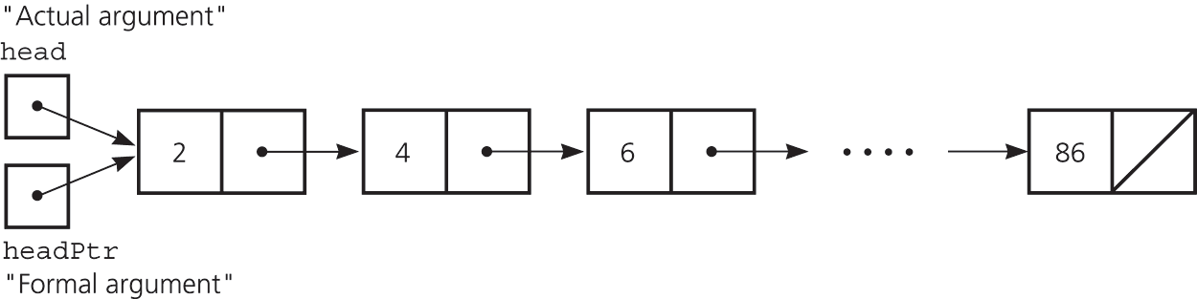
Passing a Linked List to a Function
A function with access to a linked list’s head pointer has access to the entire list
Pass the head pointer to a function as a reference argument

Slide 46
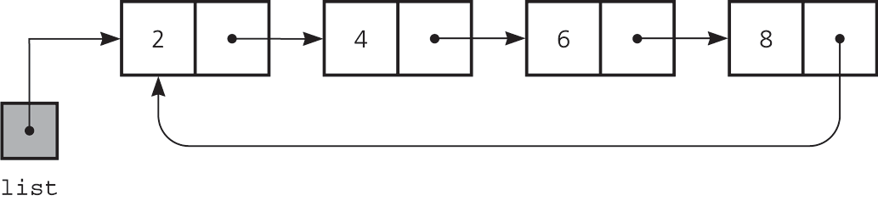
Circular Linked Lists
Last node references the first node
Every node has a successor
No node in a circular linked list contains NULL
A circular linked list

Slide 47
Circular Doubly Linked Lists
Circular doubly linked list
prev pointer of the dummy head node points to the last node
next reference of the last node points to the dummy head node
No special cases for insertions and deletions

Slide 48
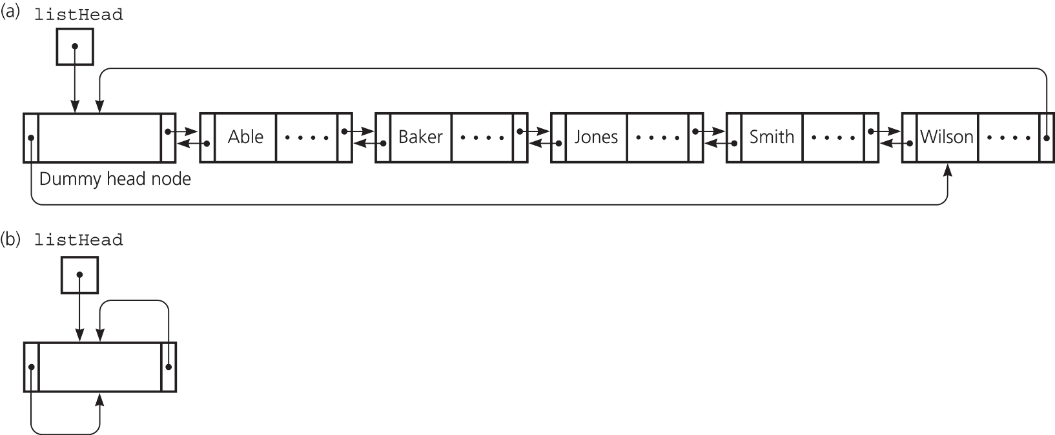
Circular Doubly Linked Lists
(a) A circular doubly linked list with a dummy head node
(b) An empty list with a dummy head node

Slide 49
Processing Linked Lists Recursively
Recursive strategy to display a list
Write the first node of the list
Write the list minus its first node
Recursive strategies to display a list backward
writeListBackward strategy
Write the last node of the list
Write the list minus its last node backward

Slide 50
Processing Linked Lists Recursively
writeListBackward2 strategy
Write the list minus its first node backward
Write the first node of the list
Recursive view of a sorted linked list
The linked list to which head points is a sorted list if
head is NULL or
head->next is NULL or
head->item < head->next->item, and
head->next points to a sorted linked list

